Slide 1

LINEAR CONTROL
SYSTEMS
Ali Karimpour
Assistant Professor
Ferdowsi University of Mashhad
Notes:
<<<1.1>>>
###Control System Design###
{{{Control, Design}}}

Slide 2
Lecture 29
Controller design in the frequency domain
Topics to be covered include:
Lead controller design

Slide 3
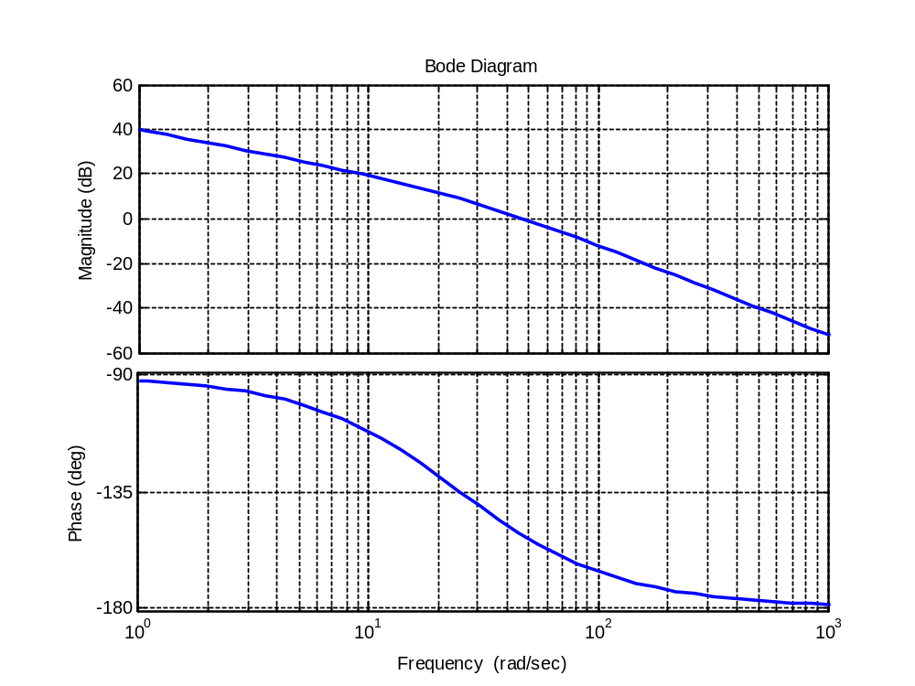


Design fundamental of lag the controller (just as a remember)
0
20 log a
0
How can the controller help us?
PM=25°
PM=40°

Slide 4
Phase-lag controller properties (just as a remember)
1- Phase-lag controller decreases the BW.
It makes the system slower.
2- It reduces the noise effect.
Decreases the noise affect on the output.

Slide 5

Design fundamental of the lead controller
20 log a
0
φ_{m}
0
How can the controller help us?
PM=25°
PM=40°

Slide 6
Phase-lead controller properties
1- Phase-lead controller increases the BW.
It makes the system faster.
2- It exaggerates the noise effect.
Increases the noise affect on the output.

Slide 7
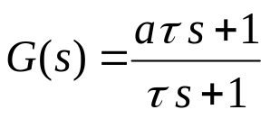


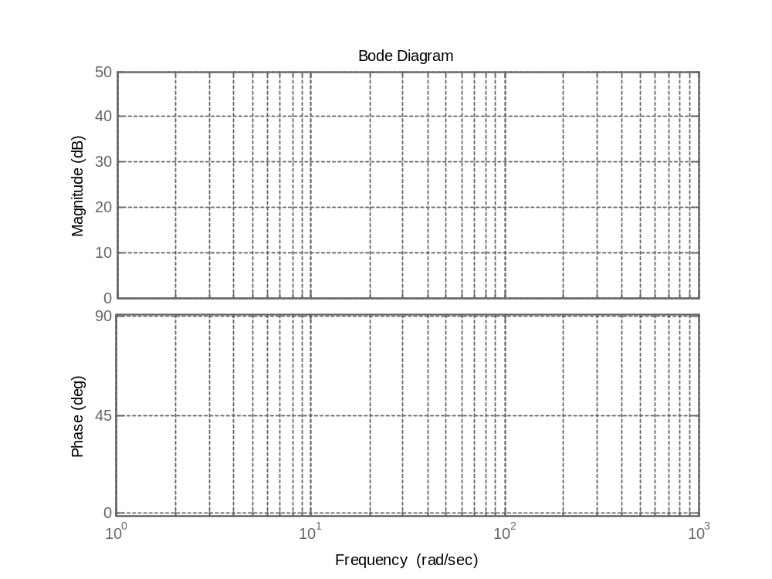










A phase-lead controller
Phase (deg) Magnitude (db)

Slide 8
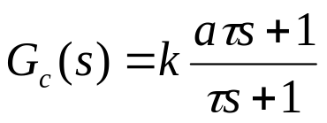

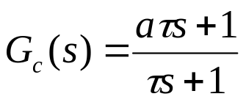
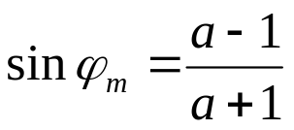



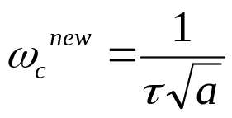


Design procedure of the phase-lead controller in the frequency domain
20 log a
0
φ_{m}
0
Step 1: Consider with as a phase lead controller.
Note: If the plant has another gain k, let
Step 2: Try to fix k according to the performance request, otherwise let k=1
Step 3: Sketch the Bode plot of the system (with the fixed k ) without controller.
Step 4: Find the system PM and if it is not sufficient choose the required phase by:
?
Step 5: Put the center of the controller in the new gain crossover frequency:
Step 6: Check the controller.

Slide 9

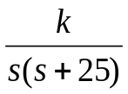


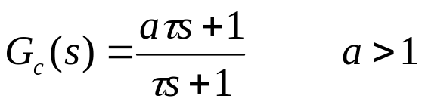
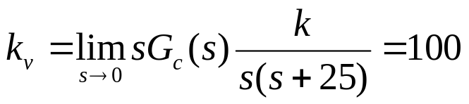

Example 1: Design a lead controller for the following system such that the phase margin be 45° and the ramp error constant be 100. Find the M_{p} of overall system.
+
-
Step 1: Consider with as a phase-lead controller.
Note: If the plant has another gain k, let
Step 2: Try to fix k according to the performance request, otherwise let k=1

Slide 10
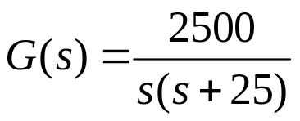
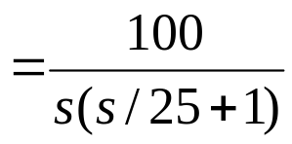


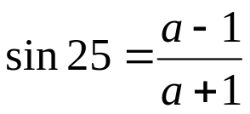

Example 1: Design a lead controller for the following system such that the phase margin be 45° and the ramp error constant be 100. Find the M_{p} of overall system.
Step 3: Sketch the Bode plot of the system (with the fixed k ) without controller.
+
-
Step 4: Find the system PM and if it is not sufficient choose the required phase by:
PM=25°

Slide 11




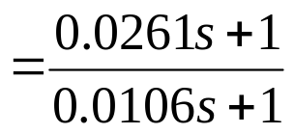

Example 1: Design a lead controller for the following system such that the phase margin be 45° and the ramp error constant be 100. Find the M_{p} of overall system.
Step 5: Put the center of the controller in the new gain crossover frequency:
+
-
PM=25°

Slide 12
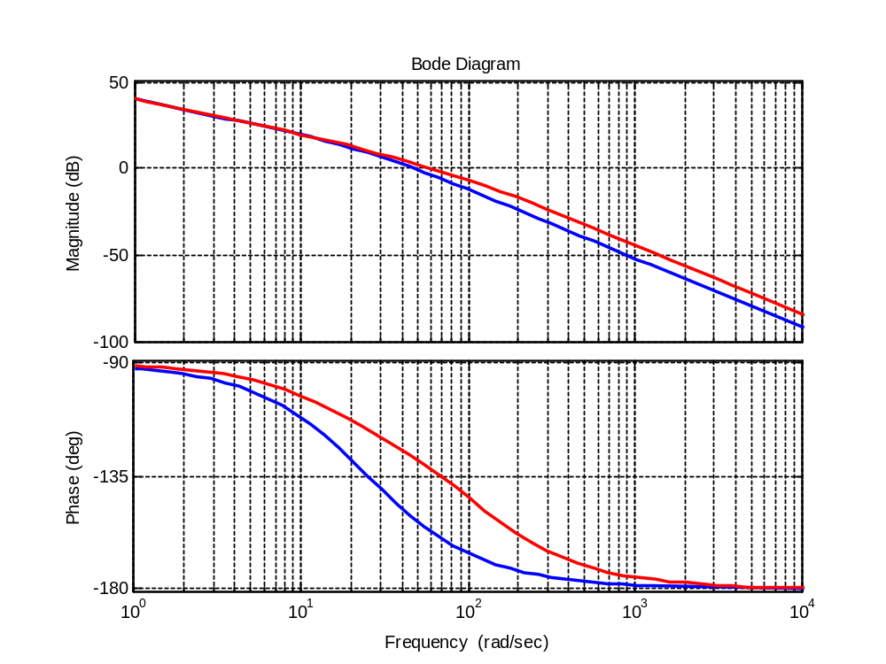



Example 1: Design a lead controller for the following system such that the phase margin be 45° and the ramp error constant be 100. Find the M_{p} of overall system.
Step 6: Check the controller.
+
-

Slide 13
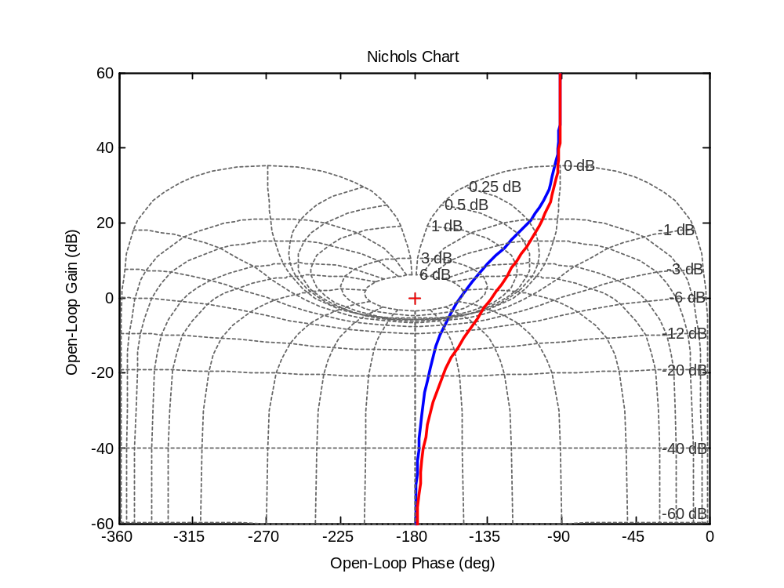
Example 1: Design a lead controller for the following system such that the phase margin be 45° and the ramp error constant be 100. Find the M_{p} of overall system.
Find M_{p}
Clearly M_{p}= 2 db
+
-

Slide 14
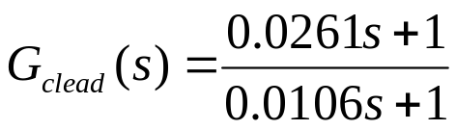
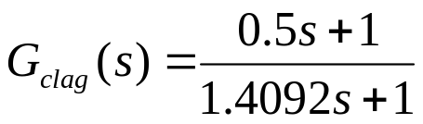
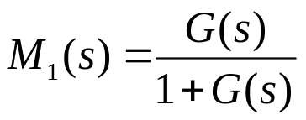
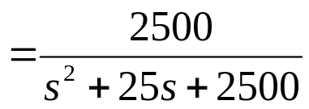
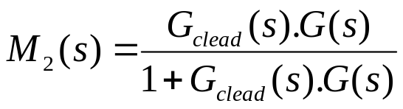
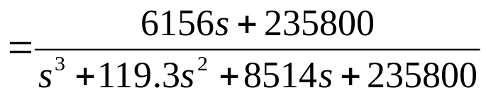
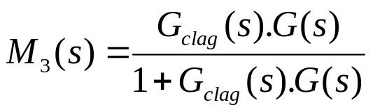
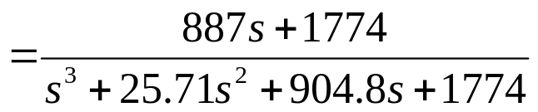
Example 2: Find the step response of example 1 and compare it with example 1 of lecture 29.
Lead controller of example 1
+
-
Lag controller of example 1 lecture 29
Closed loop transfer function without controller
Closed loop transfer function
with a phase-lead controller
Closed loop transfer function
with a phase-lag controller

Slide 15
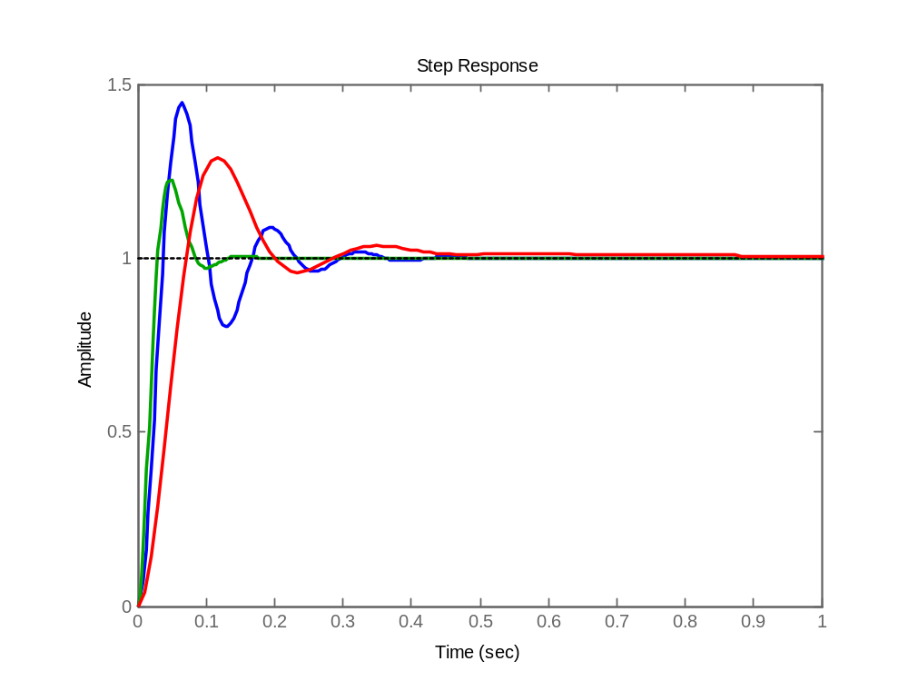
Example 2: Find the step response of example 1 and compare it with example 1 of lecture 29.
Lead controller of example 1
+
-
Lag controller of example 1 lecture 29
Without controller
Phase-lag controller
Check the speed of different controllers and compare it with the controller properties in slide #4 and #6
Phase-lead controller

Slide 16
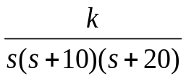
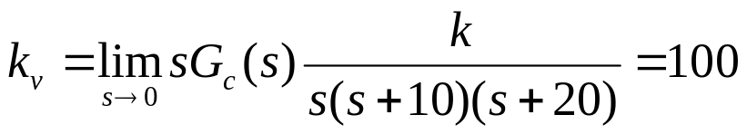

Example 3: Design a lead controller for the following system such that the phase margin be 45° and the ramp error constant be 100.
+
-
Step 1: Consider with as a phase-lead controller.
Note: If the plant has another gain k, let
Step 2: Try to fix k according to performance request, otherwise let k=1

Slide 17
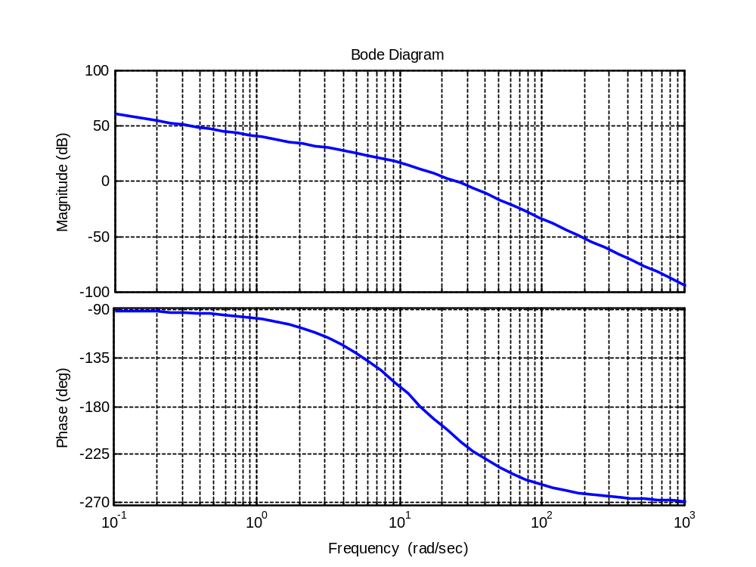
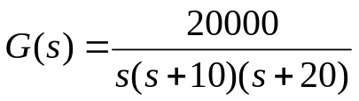
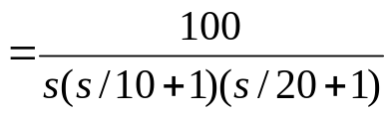


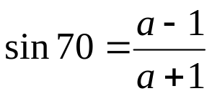

Example 3: Design a lead controller for the following system such that the phase margin be 45° and the ramp error constant be 100.
Step 3: Sketch the Bode plot of system (with the fixed k ) without controller.
+
-
Step 4: Find the system PM and if it is not sufficient choose the required phase by:
PM= -20°

Slide 18




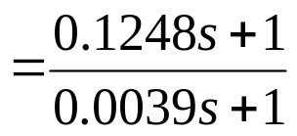

Example 3: Design a lead controller for the following system such that the phase margin be 45° and the ramp error constant be 100.
Step 5: Put the center of controller in the new gain crossover frequency:
+
-
PM= -20°

Slide 19
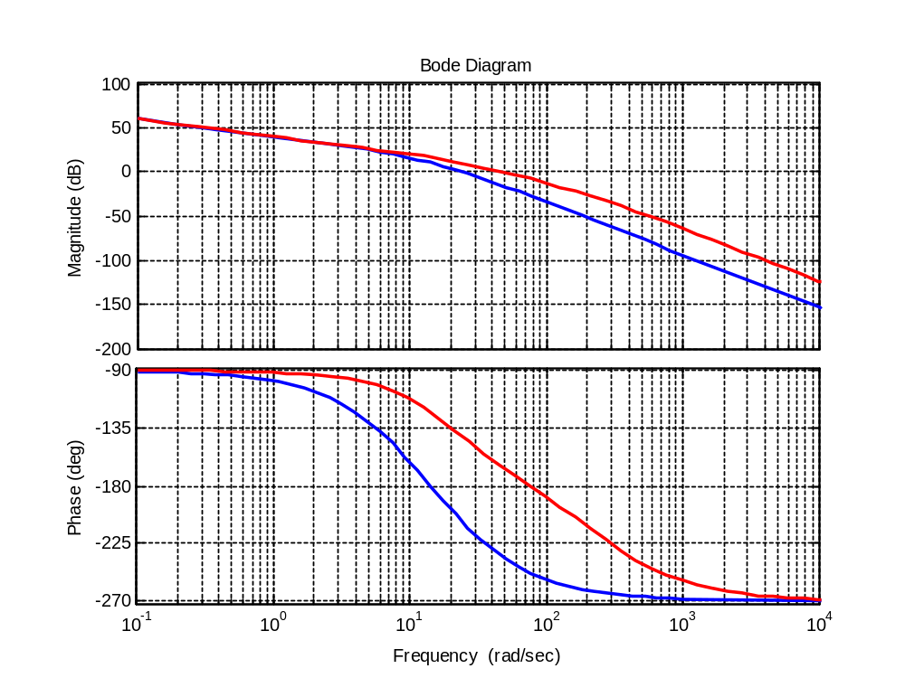

Example 3: Design a lead controller for the following system such that the phase margin be 45° and the ramp error constant be 100.
Step 6: Check the controller.
+
-
Note: Design is not possible!
Why?

Slide 20

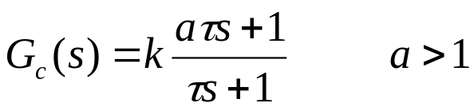
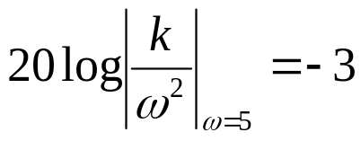

Example 4: Design a lead controller for the following system such that the phase margin be 45° and the open loop bandwidth be 10 rad/sec
+
-
Step 1: Consider with as a phase-lag controller.
Note: If the plant has another gain k, let
Step 2: Try to fix k according to performance request, otherwise let k=1
Why?

Slide 21
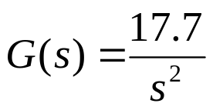
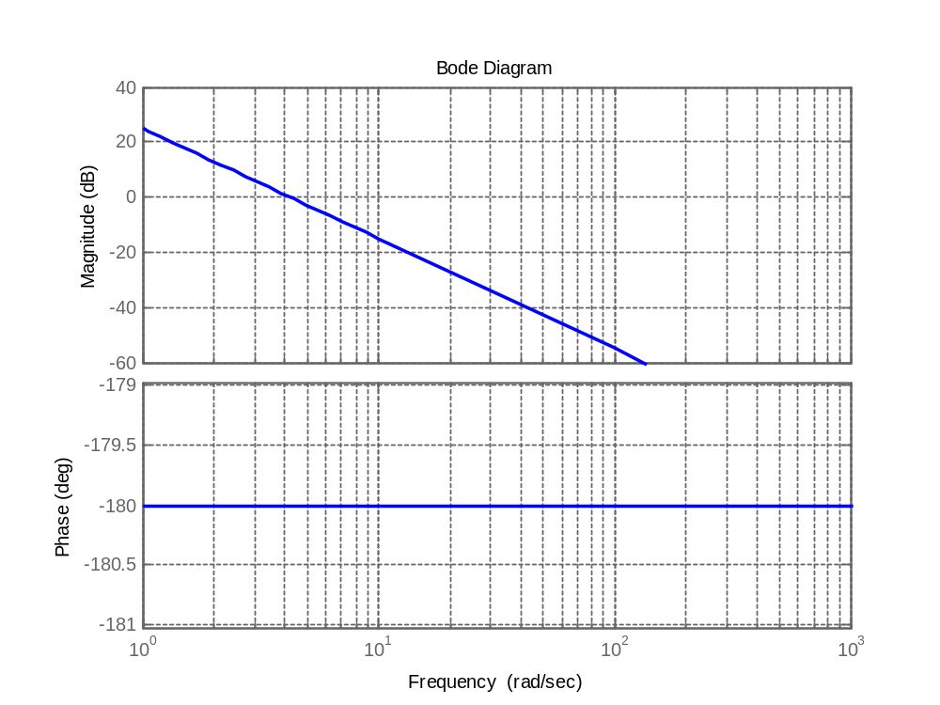


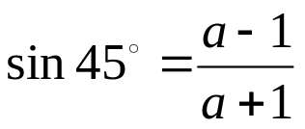

Example 4: Design a lead controller for the following system such that the phase margin be 45° and the open loop bandwidth be 10 rad/sec
Step 3: Sketch the Bode plot of system (with the fixed k ) without controller.
+
-
Step 4: Find the system PM and if it is not sufficient choose the required phase by:

Slide 22




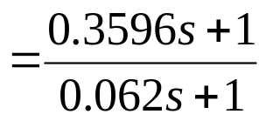

Example 4: Design a lead controller for the following system such that the phase margin be 45° and the open loop bandwidth be 10 rad/sec
Step 5: Put the center of controller in the new gain crossover frequency:
+
-

Slide 23
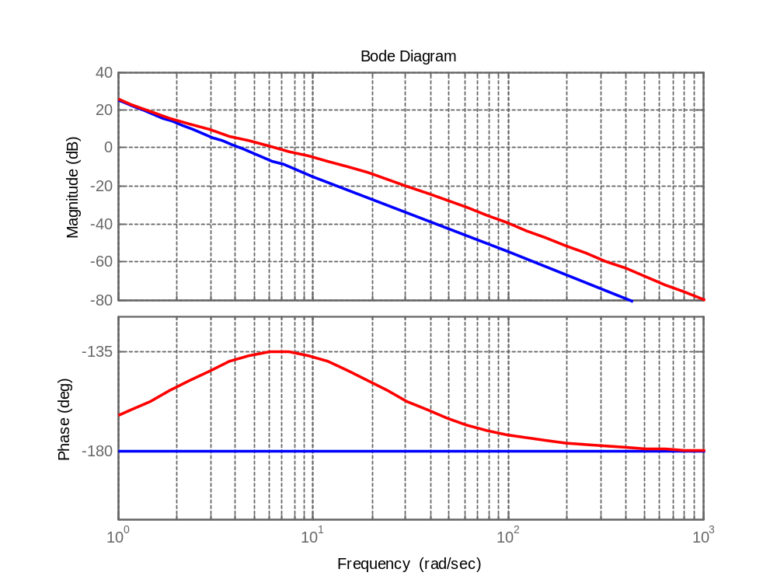



Example 4: Design a lead controller for the following system such that the phase margin be 45° and the open loop bandwidth be 10 rad/sec
Step 6: Check the controller.
+
-
Controller is not ok
Try again

Slide 24


Example 4: Design a lead controller for the following system such that the phase margin be 45° and the open loop bandwidth be 10 rad/sec
+
-
Step 2: Try to fix k according to performance request, otherwise let k=1
Open loop bandwidth is near to gain crossover frequency so:

Slide 25
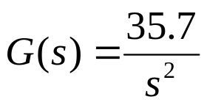
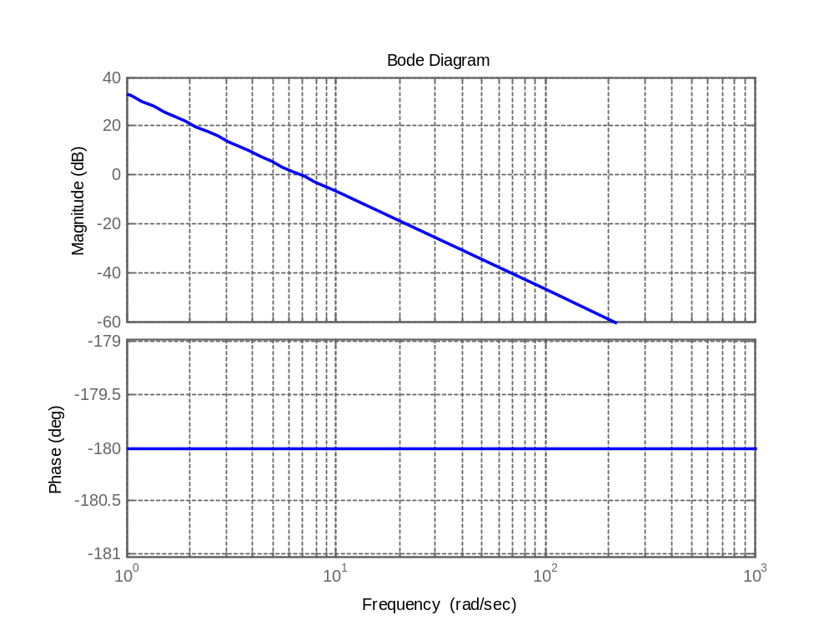

Example 4: Design a lead controller for the following system such that the phase margin be 45° and the open loop bandwidth be 10 rad/sec
Step 3: Sketch the Bode plot of system (with the fixed k ) without controller.
+
-
Step 4: Find the system PM and if it is not sufficient choose the required phase by:

Slide 26
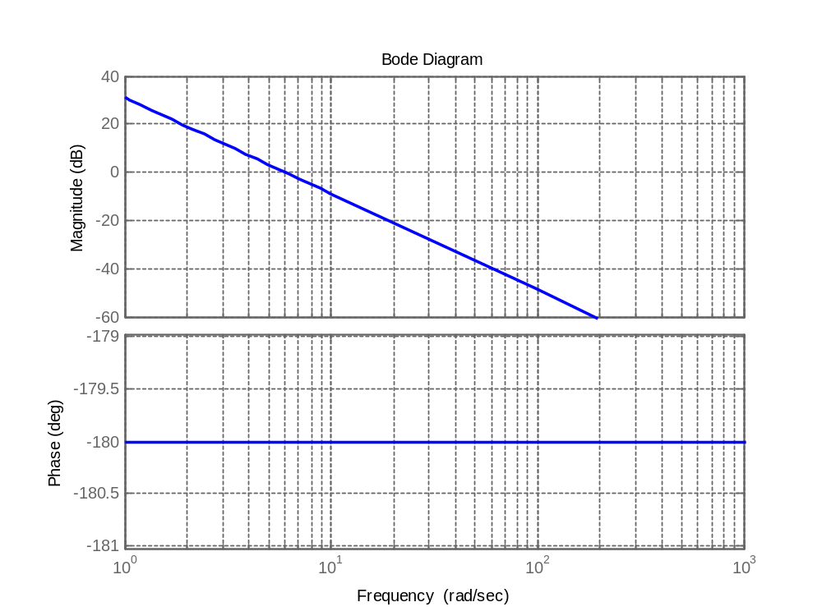


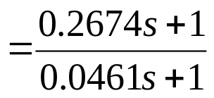
Example 4: Design a lead controller for the following system such that the phase margin be 45° and the open loop bandwidth be 10 rad/sec
Step 5: Put the center of controller in the new gain crossover frequency:
+
-

Slide 27
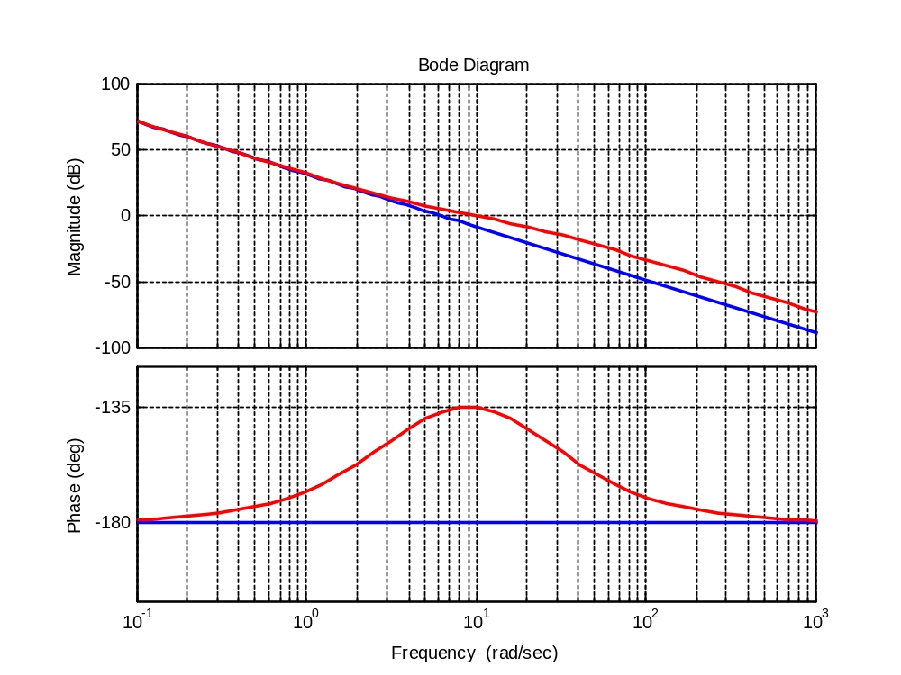

Example 4: Design a lead controller for the following system such that the phase margin be 45° and the open loop bandwidth be 10 rad/sec
Step 6: Check the controller.
+
-
Controller is not ok
Try again

Slide 28


Example 4: Design a lead controller for the following system such that the phase margin be 45° and the open loop bandwidth be 10 rad/sec
+
-
Step 2: Try to fix k according to performance request, otherwise let k=1
Open loop bandwidth is near to gain crossover frequency so:

Slide 29
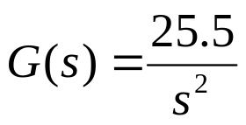
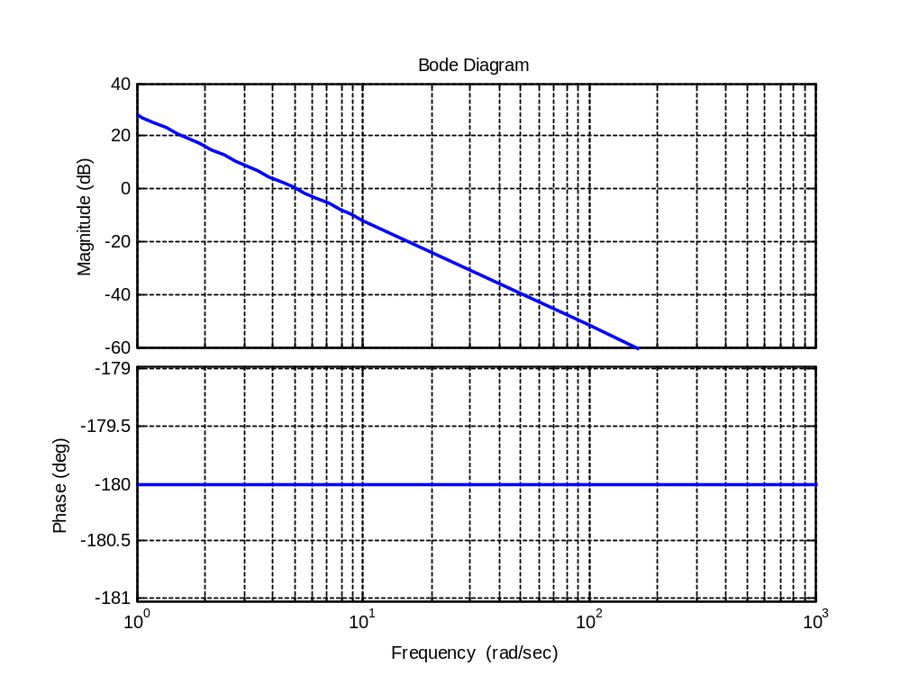
Example 4: Design a lead controller for the following system such that the phase margin be 45° and the open loop bandwidth be 10 rad/sec
Step 3: Sketch the Bode plot of system (with the fixed k ) without controller.
+
-
Step 4: Find the system PM and if it is not sufficient choose the required phase by:

Slide 30


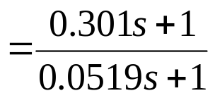
Example 4: Design a lead controller for the following system such that the phase margin be 45° and the open loop bandwidth be 10 rad/sec
Step 5: Put the center of controller in the new gain crossover frequency:
+
-

Slide 31
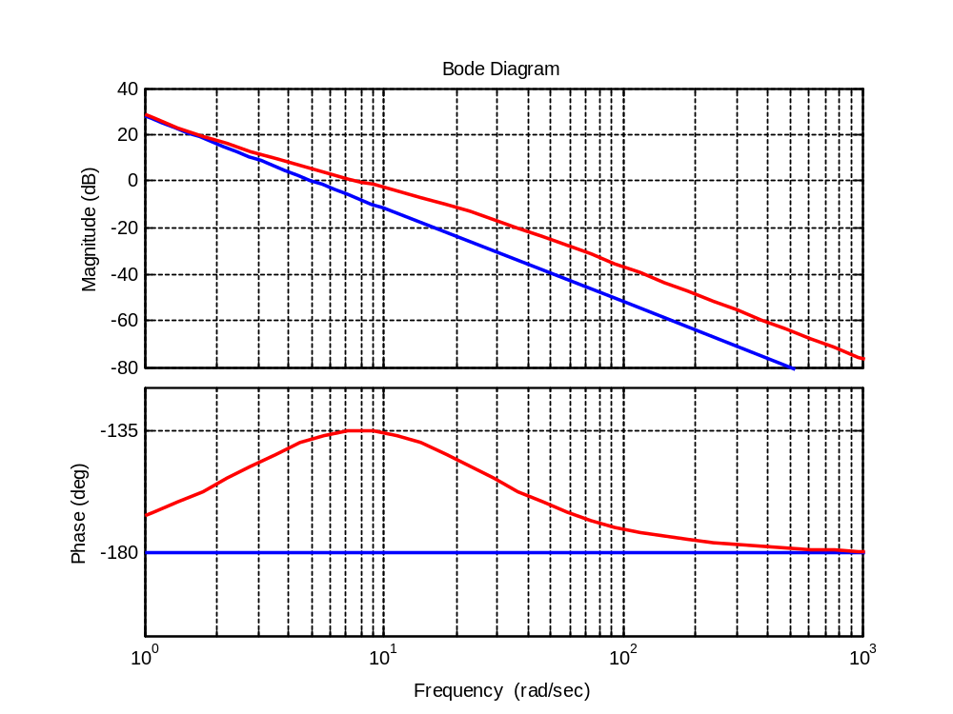

Example 4: Design a lead controller for the following system such that the phase margin be 45° and the open loop bandwidth be 10 rad/sec
Step 6: Check the controller.
+
-
Controller is ok
It can be solved by a very better method without trial and error. Try to find it.

Slide 32

Exercises
1 Design a lead controller for the following system such that the phase margin be 40° and the open loop bandwidth be 23 rad/sec
+
-
2 Design a lead controller for the following system such that the phase margin be 40° and the acceleration constant be 25.
+
-

Slide 33

Exercises
3 Following is the open loop transfer function of a system. Design a lead controller such that PM=45°. Draw the bode plot of compensated system.

Slide 34
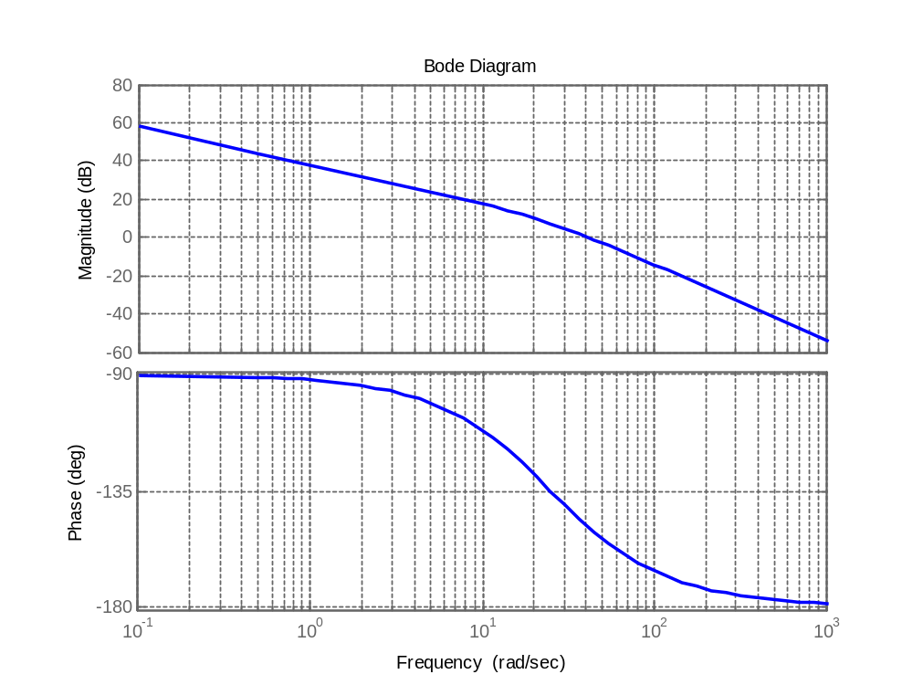
Exercises
Following is the open loop transfer function of a system.
a) What is the velocity error constant. (answer 80)
b) Design a lead controller such that PM=50°. (answer G_{c}(s)=(0.0315s+1)/(0.0126s+1))
c) Design a lead controller such that PM=50° and the velocity error constant be 200.
(answer G_{c}(s)=(0.0192s+1)/(0.0052s+1))

